Slide 1
LIBS 7001: Week 11
© BCIT
Adapted from original slides by G.Homel and C.Liotta

Slide 2
Logical Appeals and Fallacies
review the three basic argumentative appeals
identify types of evidence to support a rational appeal
define induction and deduction and when to use them
define syllogism, enthymeme, and their parts
discuss how to test the validity of a logical proposition
identify main argumentative fallacies

Slide 3
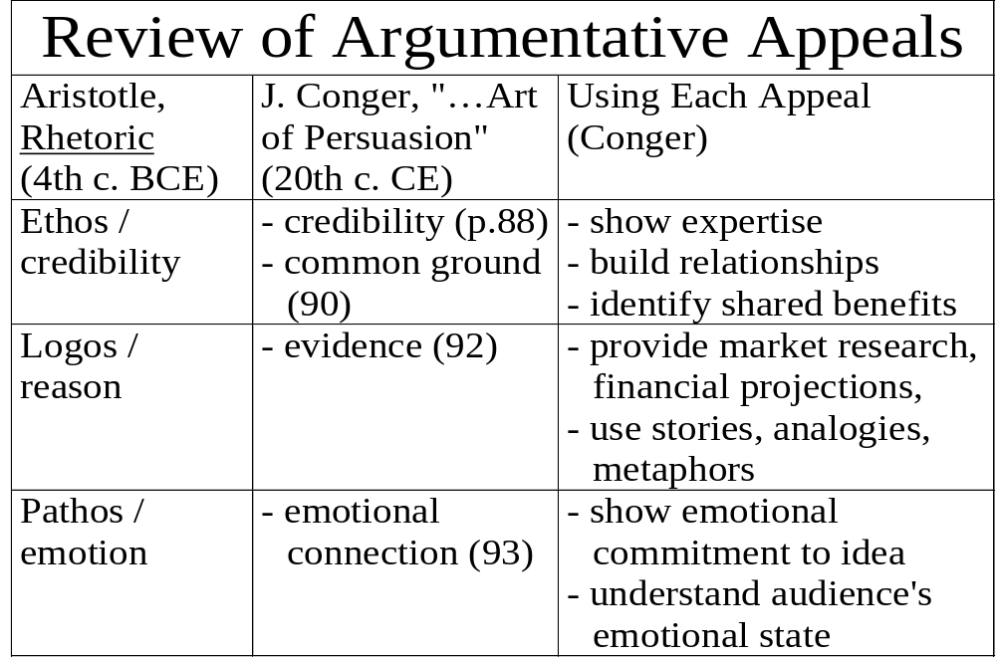

Slide 4
Types of Evidence Used to Support a Rational Appeal
(Reinking, 150-54)
Established truths: facts no one can seriously dispute; use as back-up, not main evidence.
Opinions of authorities: must cite source & avoid bias
Primary sources: those directly involved in the issue: interviews, surveys, newspapers, etc.
Secondary sources: those commenting on the issue
Statistical data: beware of bias; choose reliable, recent data; avoid misuse
Personal experience: use mainly to reinforce other evidence and only if you are an expert

Slide 5
Evaluating Content of Sources adapted from http://owl.english.purdue.edu/Files/131/c-content.html
Is the content of the source fact, opinion, or propaganda? (more on propaganda next week)
Are sources for facts clearly indicated?
Is enough evidence offered? Is coverage comprehensive?
Is the language emotional or objective?
Are there broad generalizations that overstate or oversimplify the matters?

Slide 6
Evaluating Content, cont.
Does the author use a good mix of primary and secondary sources for information?
If the source is opinion, does the author offer sound reasons for adopting that stance?
Consider the author’s credibility. Is this person or organization reputable?
Is the author qualified to speak authoritatively on the subject you’re researching?

Slide 7
Two Approaches to Argument
(J. Reinking et. al. Strategies for Successful Writing. Scarborough, ONT: Prentice Hall Ally Bacon, 2000, 152-54)
Induction: moves from separate bits of evidence to a general observation
  Five potato chips from this bag are limp and stale; the rest are probably stale, too.
Deduction: begins with a generally accepted observation, then shows how certain conclusions follow from that observation
  A profitable career requires a good education . . . therefore, students should spend more time studying.

Slide 8
More on Induction adapted from Maxine Hairston, A Contemporary Rhetoric. Dallas: Houghton Mifflin, 1978, Ch. 9 (#4-13)
useful when your audience may be resistant to your argument - you can build your case using evidence, moving from a question, or specific instances, to stating your position
important to choose sufficient, representative, accurate, and relevant evidence, and to avoid bias
examples of use: decisions made based on market research, polling
opposite is deduction (general to specific)

Slide 9
Deduction & Syllogisms
Deduction is the most common type of logical appeal; used in mathematics, business, physical & applied sciences
moves from a general truth through evidence/ specifics, to a conclusion
often based around a syllogism, a set of three statements following a fixed pattern to ensure sound reasoning.

Slide 10
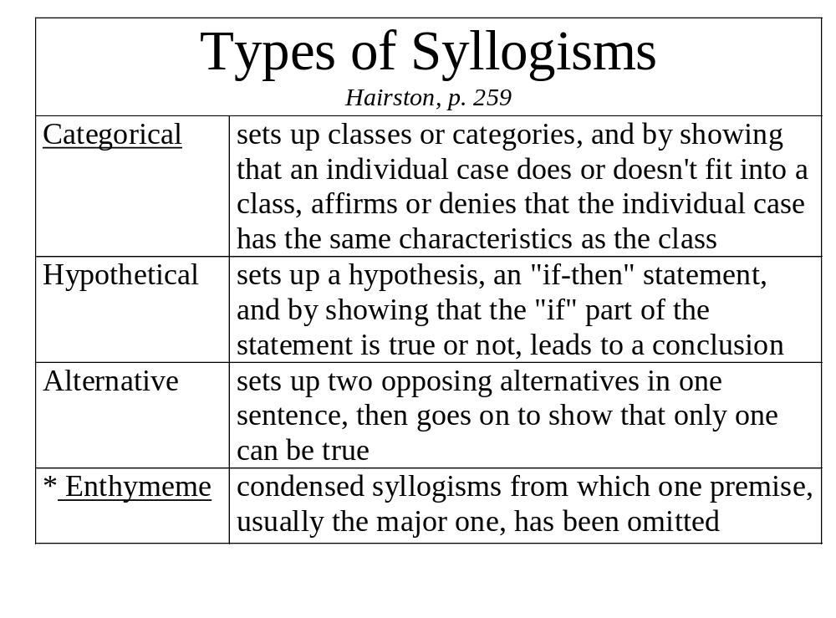

Slide 11
Parts of a Categorical Syllogism
  major premise All men are mortal.
  minor premise Socrates is a man.
  conclusion Therefore, Socrates is mortal.
major premise: names a category of things and says that all or none of them share a certain characteristic
minor premise: notes that a thing or group belongs to that category
conclusion: states that the thing or group shares the characteristics of the category
Both premises must be true, to produce a logical conclusion.

Slide 12
Syllogism Parts, cont.
  middle term major term
  major premise All persons are mortal.
  minor term middle term
  minor premise Sue is a person.
  minor term major term
  conclusion Therefore, Sue is mortal
  major term: describes the largest class; always the last term (predicate) of the conclusion
  middle term: describes class appearing in both major & minor premise
  minor term: describes individual thing or group; always subject of the conclusion

Slide 13
Avoiding Misuse of Syllogisms
Make sure any syllogism you use keeps the terms in the proper order and relationship. Invalid:
  All persons are mortal
  Sue is mortal
  Therefore, Sue is a person.
Make sure the major premise of your syllogism is in fact true: e.g., “All West Vancouverites are wealthy” is untrue.
Memorize rules for syllogisms, or use diagrams.

Slide 14
Distribution Rules
You can memorize some of the rules of distribution (including or excluding all members of a group or class) for a valid syllogism.
for example:
  the middle term must be distributed at least once (a major cause of faulty deductive reasoning)
  no term that’s not distributed in the premises may be distributed in the conclusion
  major term must be predicate term in conclusion

Slide 15
Diagramming Syllogisms
You can diagram the syllogisms to test validity.
mortals
All persons are mortal.
Sue is mortal.
Therefore, Sue is a person.
-invalid argument / undistri-buted middle term (“persons”): Sue could be a mortal creature other than a person (e.g., a cat, penguin).
persons
Sue

Slide 16
Diagramming Syllogisms, cont.
All persons are mortal.
Sue is a person.
Therefore, Sue is mortal.
-valid argument
mortal
Sue
persons

Slide 17
Enthymemes
condensed syllogisms, from which one premise, usually the major one, has been omitted.
you must provide the unstated premise, in order to check the argument for validity
most of the syllogisms we encounter are in the form of enthymemes:
  He’s an NDPer: he’ll support the tax bill.
  She's got such good ideas; she should get the promotion

Slide 18
Argumentative Fallacies adapted from W.B. Horner, Rhetoric in the Classical Tradition, Ch. 8, 1988; Reinking, et. al., pp. 159-62 & Thos. Kane, Oxford Guide to Writing, 1983
Testing arguments can help reveal errors in reasoning -- or fallacies. Types and foci:
  Material Fallacies: focus on the truth of the premises, and the material on which the conclusion is built
  Logical Fallacies: focus on the validity of the chain of reasoning
  Psychological / Emotional Fallacies: lead to faulty reasoning by diverting attention / clouding the issue

Slide 19
Material Fallacies
Faulty Generalization: a broad, unsupported statement about a class of people or things.
  He graduated from university, so he must be smart
  Men can never ask for directions when they're lost
Insufficient Sampling:: generalizing from a small sample of evidence: I'll never buy fruit at that store again; this banana is rotten

Slide 20
Material Fallacies, continued
Unrepresentative Sampling: generalizing from a biased sample:
  [polling only environmentalists about using pesticides, or Fraser Institute members about results of tax cuts]
Card-Stacking: deliberately selecting only the evidence supporting your position:
  Students have an easy life -- they get to sit in a classroom all day long and read lots of books.

Slide 21
Logical Fallacies
Faulty Cause (post hoc, ergo propter hoc): asserting that because one thing happened before the other, the first caused the second: It’s raining because I washed my car.
False Alternatives (Either/Or): presenting only two of many alternatives: You’re either with us or with the terrorists.
Rigged Question: the yes-or-no answer to which will support the questioner’s position: Have you ever been arrested? (yes or no)
Arguing off the Point/ Avoiding the Question (evasive tactic - breaks the chain of reasoning): Q: Was this a terrorist attack? A: All the resources of the NTSB and FAA will be used in the investigation.

Slide 22
Logical Fallacies, cont.
Equivocation: using word-play to confuse meaning: Joe's religion is Catholicism, but Janet's religion is money.
Non Sequitor (two ideas not logically connected)
  Bill's been out every night this week; who is she?
Begging the Question: determining the answer to a question by the way you ask it (as in “corrupt” below):
  We can’t re-elect this corrupt official, can we?
Circular Argument: restates the assertion; no evidence
  Pauline’s a good manager because she manages effectively.

Slide 23
Psychological Fallacies
Ad Hominem: attacking the person, not the argument:
  James is so weird-looking. How can you trust his ideas on the economy?
Guilt by Association: She's the sister of that bank robber, so she must be a criminal, too.
Appeal to Force: Sign the agreement or we’ll boycott.
Argument to the Club (subtle appeal to force)
  We’re willing to give you debt relief if…
Bandwagon: pressure to conform to supposed group values:
  But everyone’s going -- why can't I?

Slide 24
Psychological Fallacies, cont.
Name-Calling (emotional form of faulty generalization)
  Those angry, whining feminists…
Glittering Generalities: opposite of name-calling; motherhood; our great nation; faith in God
Fallacy of the golden past
  Things were better in the old days (.. the 1960s…)
Fallacy of progress (suggests a movement forward in time towards some transcendent “future”)
  Things keep getting better every day in every way…

Slide 25
Psychological Fallacies, cont.
Appeal to Ceremony or Setting
  [doctors & policemen in uniforms on TV shows].
  To be the boss, dress and act like the boss.
Appeal to Authority (faulty or otherwise)
  This Nobel-prize-winning researcher recommends….
  Drink Gatorade, like Vince Carter!
Appeal to Tradition
  We've always done it this way.

Slide 26
Psychological Fallacies, cont.
Appeal to Ignorance / Failure to Find Proof
  Can you prove God exists? Well, then God doesn't exist.
Appeal to Humour (deflects attention from logic)
  Do you descend from apes on your mother's or father's side?
Appeal to Pity
  Your honour, my client has five young children and a sick husband …
  The computer crashed and I lost all my work.

Slide 27
Psychological Fallacies, cont.
Argument to the person (appeal to audience’s personal bias, ignoring other claims):
  A tax cut will put more money in your pocket.
Appeal to the Crowd: falsely suggests deference to the supposed wisdom of the audience
  We all know that freedom is under attack.
Faulty Analogy: links two things / persons that are not enough alike: I'm going to be a great inspiration with my class, just like Gandhi and his nation.

